Slide 1
continuous delivery in a primeval environment

Slide 2

Thomas Cook
We are very proud to serve more than 20 million who choose to travel with us annually
Our timeless spirit of innovation started in 1841 and it is this that makes us stand out from the crowd
Thomas Cook Group plc is one of the world’s leading leisure travel groups with sales of £7.8 billion in the year ending 30 September 2015.
Thomas Cook is supported by 22,000 employees
Operates from 15 source markets
Is number one or two (by revenue) in all its core markets.
Thomas Cook Group plc’s shares are listed on the London Stock Exchange (TCG)

Slide 3





Slide 4
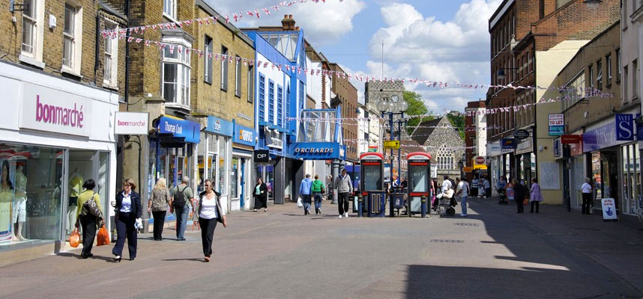

Slide 5


Slide 6
What Do We Do
What does the business do
What are the core drivers
Sells Holiday Packages
Flights
Hotels
City Breaks
Ancillary services
Currency
Better customer experiences
Higher quality
Increased Velocity
Greater stability
Faster site
Multiple Device
Better Tools
Sell more – make more

Slide 7
The Fun Part
What did we build
Some of the Tools
Continuous Integration Environment
Dry Run jobs
Dynamic Environments (Pre Commit)
Integration Environment
Continuous Delivery Environment
Pipelines for projects
Environmental control
Visibility
Chef
Jenkins
Code Climate
Sonarquabe
Sinopia
Maven
RackSpace
Softlayer

